Slide 1






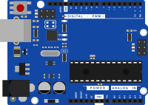


project
Water tank control system:
MINI-
HACKATHON
project

Slide 2




TEAM
HYDRO HACKERS
Ritesh Bogati
Bibek Shrestha
Shitala Adhikari
Bipasha Niraula

Slide 3
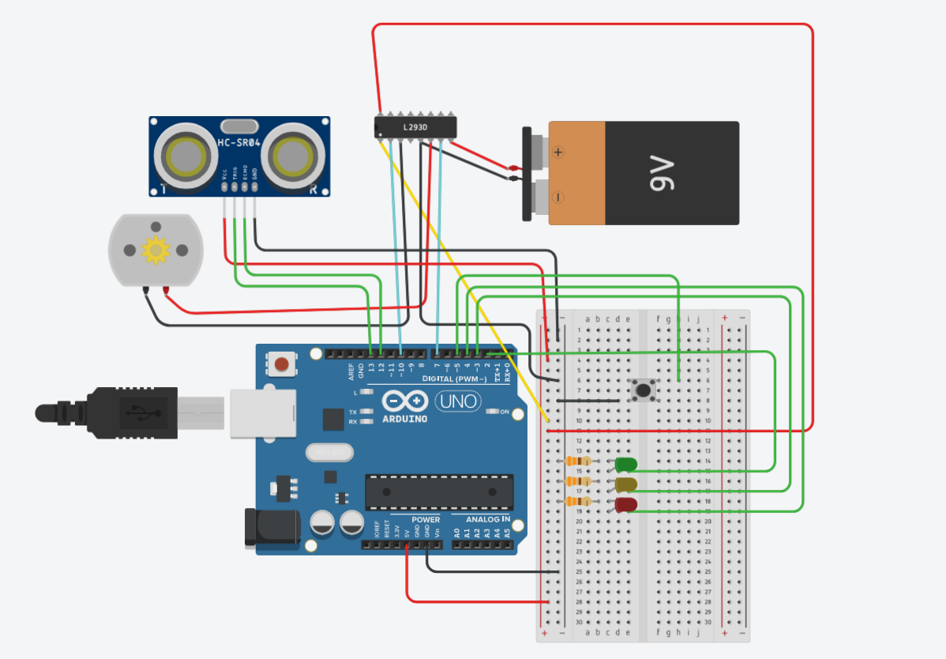
TO UNDERSTAND THE CIRCUIT:
Here we can see the circuit of
“water tank control system”
on tinkercad
Used component:
*arduino
*ulrtasonic sensor
*water motor
*motor driver
*cell
*push bottom
*led
*jumper wire
o

Slide 4
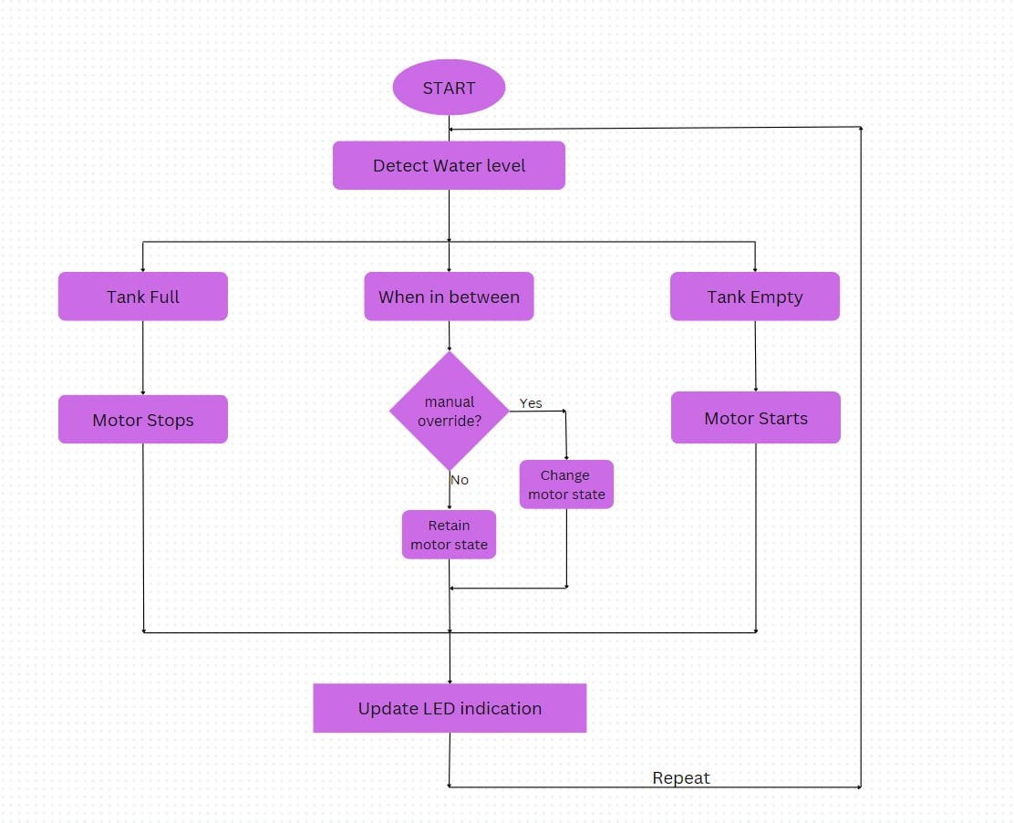
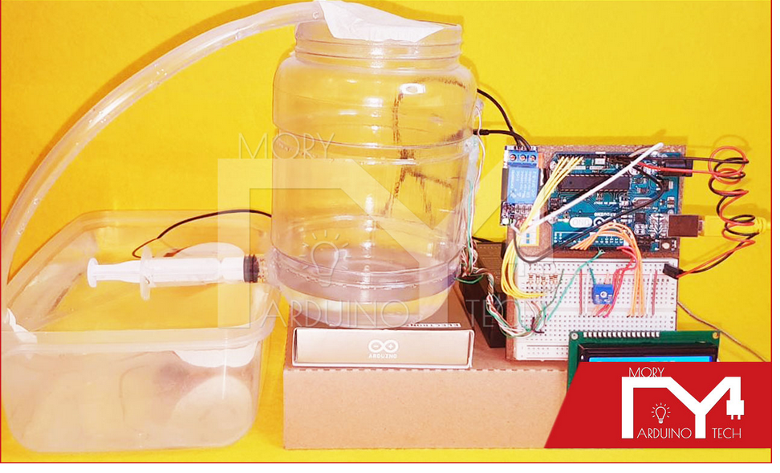
working process:
water tank control system

Slide 5

what are the issues it can tackle?
1 in 4 people globally will face water
scarcity by 2025(UN report)
Over 30% of water is wasted due to
overflow and leakage in storage tanks world wide

Slide 6

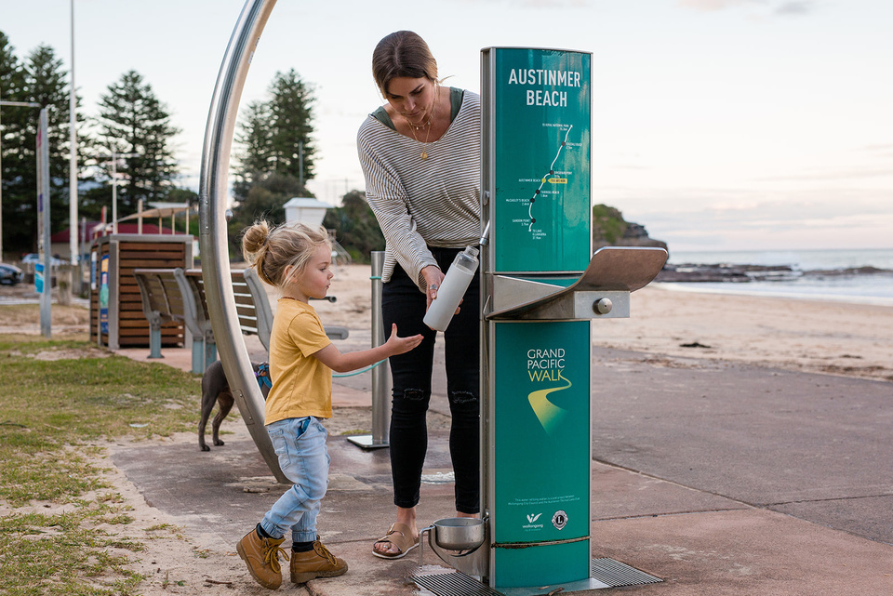

improvement
Can use float sensors for better reading
Can use GSM modules or IOT for remote monitoring
Can cantrol multiple tanks

Slide 7

it’s use:
*Households: Ensuring a steady water
supply for drinking, cooking,
and cleaning.
*Industrial Use: Providing a consistent
flow of water or chemicals in
manufacturing processes.
*Gardening and Agriculture: Maintaining
optimal soil moisture levels
with irrigation systems.

Slide 8
Advantages :
1. Convenience
Automated Operation: Sensors and mechanisms ensure the tank refills itself as needed without human intervention.
2. Time-Saving
Continuous Availability: Ensures a constant supply of water or other liquids, reducing downtime.
3. Water Conservation
Minimized Waste: Automatic systems prevent overflow by stopping refilling when the tank reaches its capacity.
Efficient Usage: Sensors can optimize water use, ensuring just the right amount is replenished.
4. DIY potential
it can fix something or create an object that addresses what is missing .
5. Cost-Effectiveness
Lower Maintenance Costs: Automated systems can reduce wear and tear associated with overuse or misuse of pumps and valves.
6. Environmental Sustainability
Smart Integration: Can be connected to systems like rainwater harvesting, ensuring sustainable water usage.

Slide 9


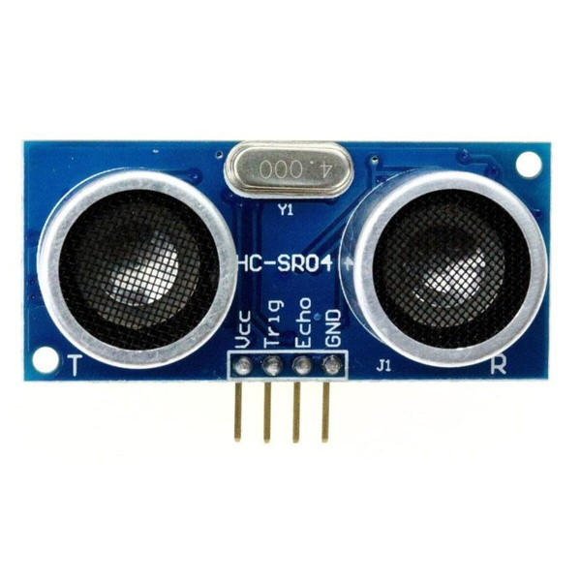
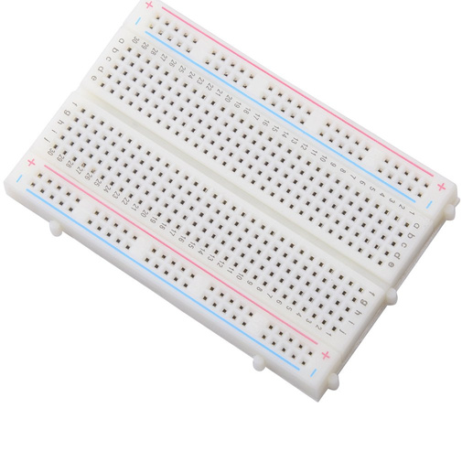
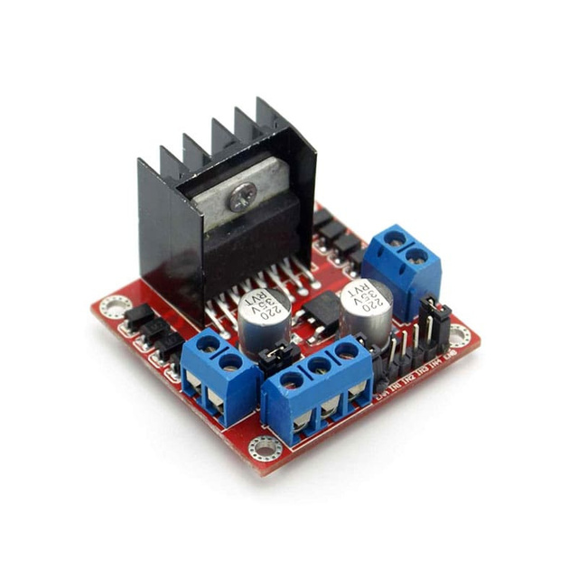
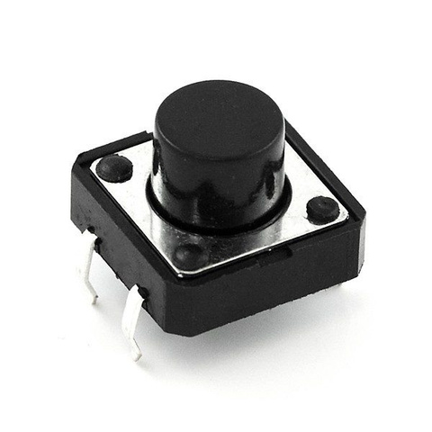
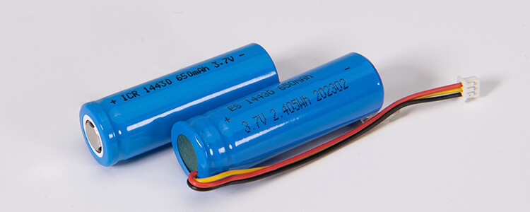
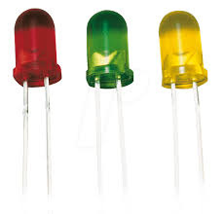
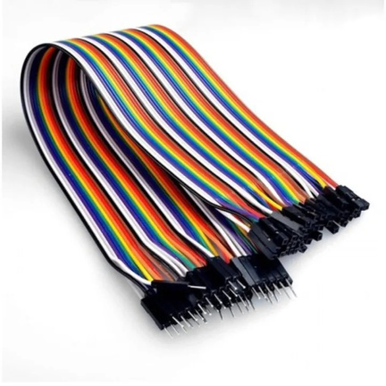
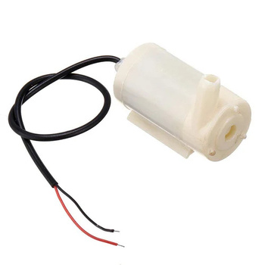
Cost of the product use in the project:
ARDUINO:RS 1250
ULTRASONIC
SENSOR:RS 200
BREAD-BOARD:
RS 230
MOTOR DRIVER:
370
JUMPER WIRE
:RS 210
WATER MOTOR
:RS 200
PUSH BUTTOM:
RS 50
BATTERY:RS 200
LED:RS 100

Slide 10


Busness-Aspect:
Can sell system as pre-assembled kit or DIY assembly kit
Two versions: -Basic(without IOT)
-Premium(with IOT)
3. Subscription services:-
-Monthly fee for cloud-based water monitoring
-Advanced analytics for water usage platform
4.Sustainable & Future Expansion :-
-Integration with smart home system :
* Compatible with Alexa or google
*IOT features(remote control)
-Solar-powered systems:
-AI & Analytics:
*Machine learning to predict water usage patterns

Slide 11

THANK YOU!

